Slide 1
Applied Data Science with R Capstone project
<Jonathan Santiago Castro Evia>
<03.30.2024>

Slide 2

Outline
Executive Summary
Introduction
Methodology
Results
Conclusion
Appendix

Slide 3

Executive Summary
The objective of the project was to predict how weather affects the use of bike sharing product demand. In order to optimize the supply.
The following datasets were used:
The Seoul Bike Sharing Demand Data Set
The Wikipedia “List of bicycle sharing systems” entry
World Cities Data (to get information such as coordinates and names from major cities
Data wrangling was performed to prepare the datasets for further analysis.
Exploratory Data Analysis was used afterwards to detect patterns and trends in the information. This was done using RSQLite which allows a dataset to be queried using SQL.
Then a simple linear regression model was built to predict the number of bikes rented each hour based on weather factors.
Lastly, an interactive map was built on a live dashboard, using R’s Shiny Package.

Slide 4

Introduction
Bike Sharing systems are a great way of moving in the cities that offer it, as it allows you to use a green transportation mode without having to have your own.
There are many factors that affects its demand, and one of those is the weather, then it would be useful to implement actions based on data to improve the service offered.
The goal of this project is to create a tool that allows the offerors and demanders a visualization of how weather affects the service so they can think of their own actions and procedures.

Slide 5

Methodology
Perform data collection
Perform data wrangling
Perform exploratory data analysis (EDA) using SQL and visualization
Perform predictive analysis using regression models
How to build the baseline model
How to improve the baseline model
Build a R Shiny dashboard app

Slide 6
Methodology

Slide 7

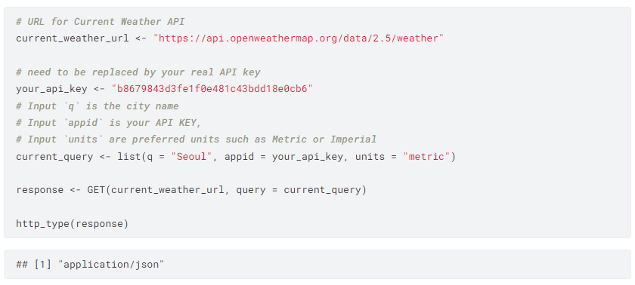


Data collection
API Request
Web Scraping
Download
Data was requested from the OpenWeather API, scraped from a Wikipedia page and downloaded through IBM Cloud Storage.

Slide 8

Data wrangling
The purpose of this stage is to clean the data by looking for noise in the dataset. The process looks like this:
string
Regular expressions
dplyr
Raw Data
Processed Data

Slide 9
EDA with SQL
Exploratory Data Analysis was performed on the datasets using Structured Query Language. The following are the purposes of the queries performed:
Determine how many records are in the seoul_bike_sharing dataset.
Determine how many hours had non-zero rented bike count.
Query the weather forecast for Seoul over the next 3 hours.
Find which seasons are included in the Seoul bike sharing dataset.
Find the first and last dates in the Seoul Bike Sharing dataset.
Determine which date and hour had the most bike rentals.
Determine the average hourly temperature and the average number of bike rentals per hour over each season. List the top ten results by average bike count.
Find the average hourly bike count during each season.
Determine the average of the attributes per season.
Determine the Total Bike Count and City Info for Seoul
Find all city names and coordinates with comparable bike scale to Seoul's bike sharing system.

Slide 10
EDA with data visualization
Exploratory Data Analysis was also performed to visually inspect the datasets using the ggplot2 library. The ggplot2 library was used to:
Create a scatter plot of `RENTED_BIKE_COUNT` vs `DATE`.
Create the same plot of the `RENTED_BIKE_COUNT` time series, but now add `HOURS` as a color.
Create a histogram overlaid with a kernel density curve.
Create a scatter plot to visualize the correlation between `RENTED_BIKE_COUNT` and `TEMPERATURE` by `SEASONS`.
Create a display of four boxplots of `RENTED_BIKE_COUNT` vs. `HOUR` grouped by `SEASONS`.
Create a line plot after grouping the data by `DATE` and using the summarize() function to visualize the daily total rainfall and snowfall.

Slide 11
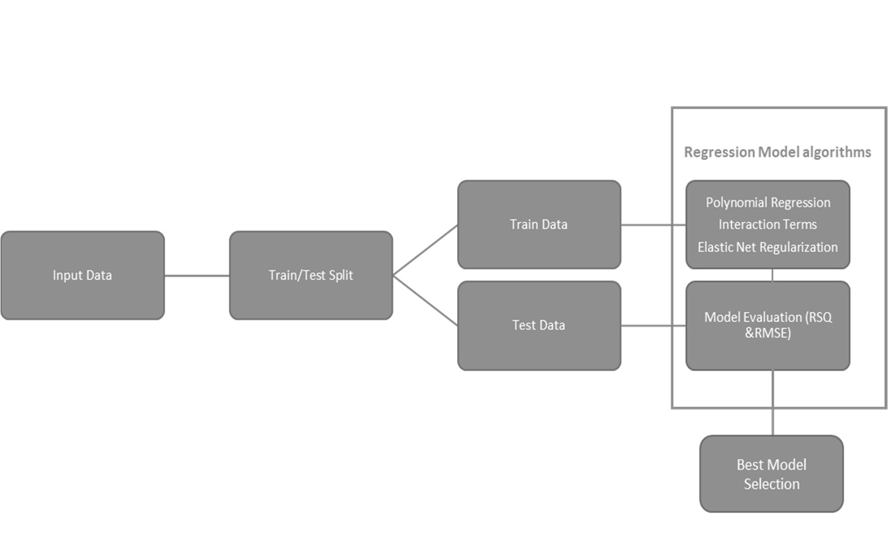
Predictive analysis
In this stage different model were built to predict the number of bikes that would be rented each hour of the day by taking weather factors into account.
The processed data was divided in two sets: a training and testing one. Then the models were evaluated using RMSE and RSQ metrics and the best model would be the one with the lowest RMSE and highest RSQ values.

Slide 12
Build a R Shiny dashboard
The results of the predictive linear regression model were combined with an interactive dashboard created using the shiny package in R. This dashboard contained:
A basic max bike prediction overview map.
A static temperature trend line.
An interactive bike-sharing demand prediction trend line.
A static humidity and bike-sharing demand prediction correlation plot

Slide 13
Results
Exploratory data analysis results
Predictive analysis results
A dashboard demo in screenshots

Slide 14
EDA with SQL

Slide 15
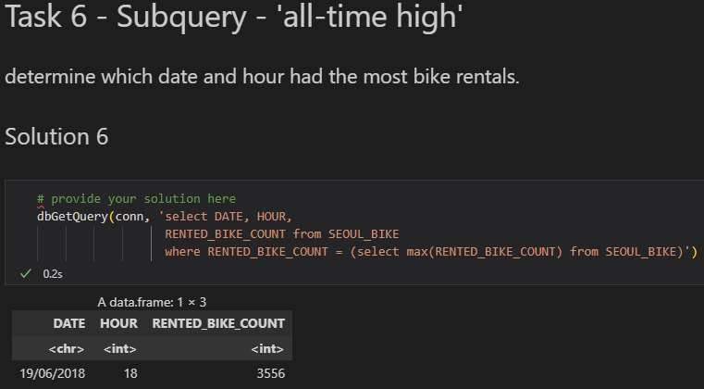
Busiest bike rental times
In order to determine which date and hour had the most bike rentals, the following query was used:
“dbGetQuery(conn, 'select DATE, HOUR, RENTED_BIKE_COUNT from
SEOUL_BIKE where
RENTED_BIKE_COUNT =
(select max(RENTED_BIKE_COUNT) from SEOUL_BIKE)’)”
The result of the query showed that at 6 P.M. on 19/06/2018, the highest ever number of bikes was rented with a total of 3556 bike.

Slide 16
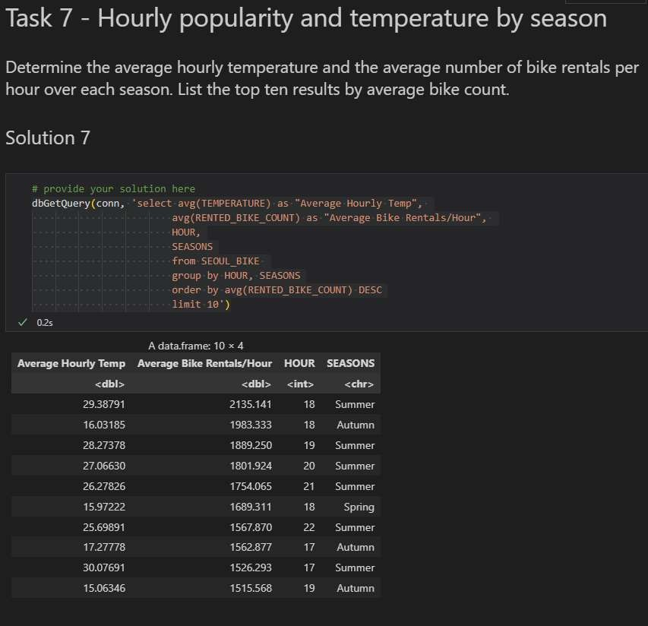
Hourly popularity and temperature by seasons
In order to determine the average hourly temperature and the average number of bike rentals per hour over each season, the following query was used:
“dbGetQuery(conn, 'select avg(TEMPERATURE) as "Average Hourly Temp", avg(RENTED_BIKE_COUNT) as "Average Bike Rentals/Hour", HOUR, SEASONS
from SEOUL_BIKE
group by HOUR, SEASONS
order by avg(RENTED_BIKE_COUNT) DESC limit 10’)”
The result of the query showed that more bikes were rented during Summer, Autumn and Spring, between the 5 and 10 PM and at temperatures between 15 and 30 degrees Celsius which are typical Autumn, Summer and Spring temperatures.

Slide 17
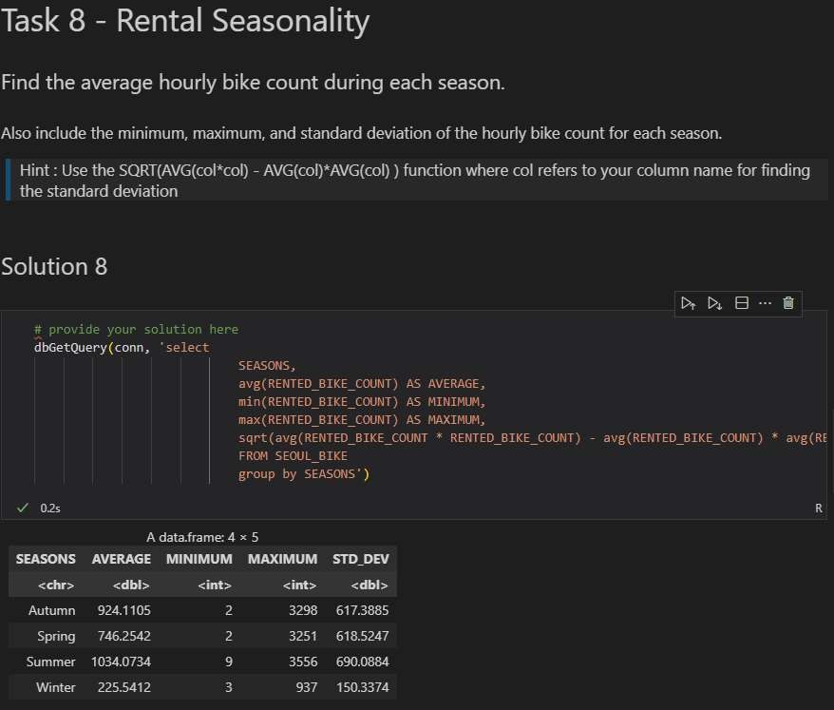
Rental Seasonality
In order to determine the average hourly bike count during each season, the following query was used:
“dbGetQuery(conn, 'select
SEASONS,
avg(RENTED_BIKE_COUNT) AS AVERAGE, min(RENTED_BIKE_COUNT) AS MINIMUM, max(RENTED_BIKE_COUNT) AS MAXIMUM,
sqrt(avg(RENTED_BIKE_COUNT * RENTED_BIKE_COUNT) - avg(RENTED_BIKE_COUNT) * avg(RENTED_BIKE_COUNT)) AS STD_DEV
FROM SEOUL_BIKE
group by SEASONS')”
The result of the query showed that, on average, more bikes were rented during Summer and fewer bikes were rented during Winter.

Slide 18
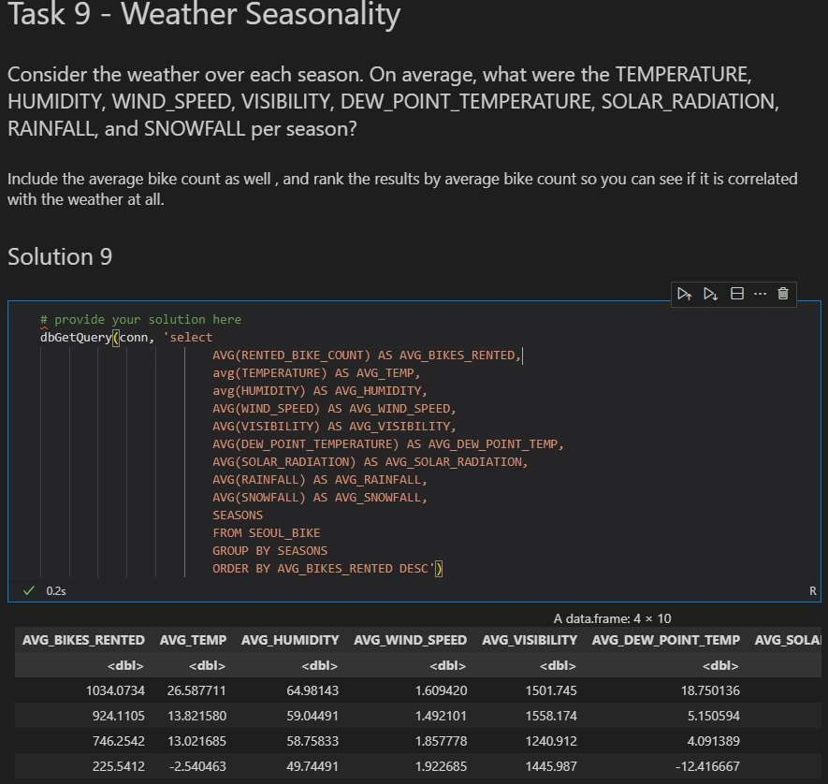
Weather Seasonality
In order to answer the question: On average, what were the TEMPERATURE, HUMIDITY, WIND_SPEED, VISIBILITY, DEW_POINT_TEMPERATURE,SOLAR_RADIATION, RAINFALL, and SNOWFALL per season?, the following query was used:
“dbGetQuery(con," SELECT SEASONS, AVG(RENTED_BIKE_COUNT) as AVG_S_COUNT, AVG(TEMPERATURE) as AVG_S_TEMP, AVG(HUMIDITY) as AVG_S_HUMIDITY, AVG(WIND_SPEED) as AVG_WIND_SPEED, AVG(VISIBILITY) as AVG_VISIBILITY, AVG(DEW_POINT_TEMPERATURE) as AVG_DEW_POINT, AVG(SOLAR_RADIATION) as AVG_SOLAR_RADIATION, AVG(RAINFALL) as AVG_RAINFALL, AVG(SNOWFALL) as AVG_SNOWFALL FROM seoul_bike_sharing
group by (SEASONS)
Order by AVG_S_COUNT desc")”
The results showed that the temperature, rainfall, humidity, snowfall, etc. readings were very correlated with the season of the year. For example, there was a higher average temperature and rainfall in the summer, while snowfall was confined to the winter season. It also showed a correlation between the number of rented bikes and the season of the year.

Slide 19
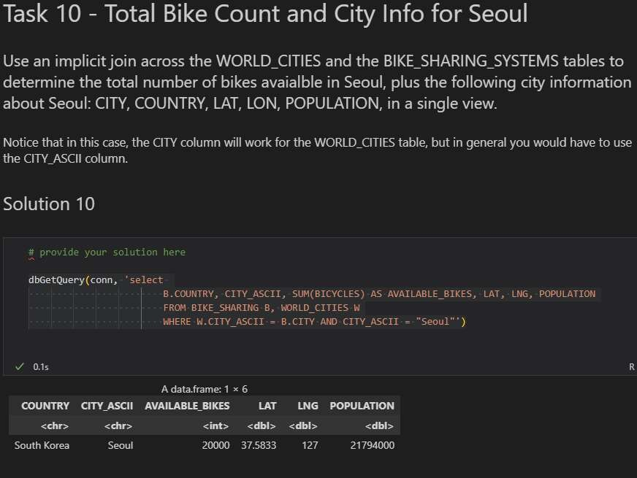
Bike-sharing info in Seoul
In order to determine the total number of bikes available in Seoul, the following query was used:
“dbGetQuery(conn, 'select
B.COUNTRY, CITY_ASCII, SUM(BICYCLES) AS AVAILABLE_BIKES, LAT, LNG, POPULATION
FROM BIKE_SHARING B, WORLD_CITIES W WHERE W.CITY_ASCII = B.CITY AND CITY_ASCII =
"Seoul"')”
The result of the query showed that there were 20,000 bikes available for rent in the city of Seoul.

Slide 20
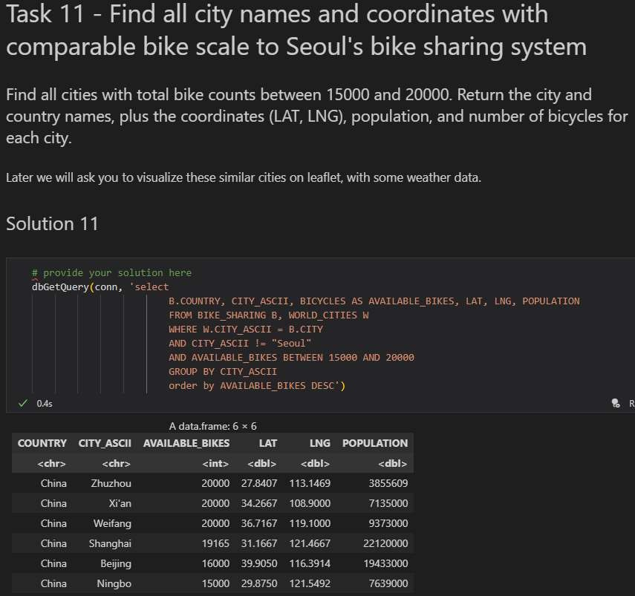
Cities similar to Seoul
In order to determine all cities having a similar number of bikes for rental like Seoul(i.e. total bike counts between 15000 and 20000), the following query was used;
“dbGetQuery(conn, 'select
B.COUNTRY, CITY_ASCII, BICYCLES AS AVAILABLE_BIKES, LAT, LNG, POPULATION
FROM BIKE_SHARING B, WORLD_CITIES W
WHERE W.CITY_ASCII = B.CITY AND AVAILABLE_BIKES BETWEEN 15000 AND 20000
GROUP BY CITY_ASCII
ORDER BY by AVAILABLE_BIKES DESC')”
The result of the query showed that six cities in China namely; Zhuzhou, Xi’an, Weifang, Shanghai, Beijing and Ningbo had similar number of rental bikes like Seoul.

Slide 21
EDA with Visualization

Slide 22
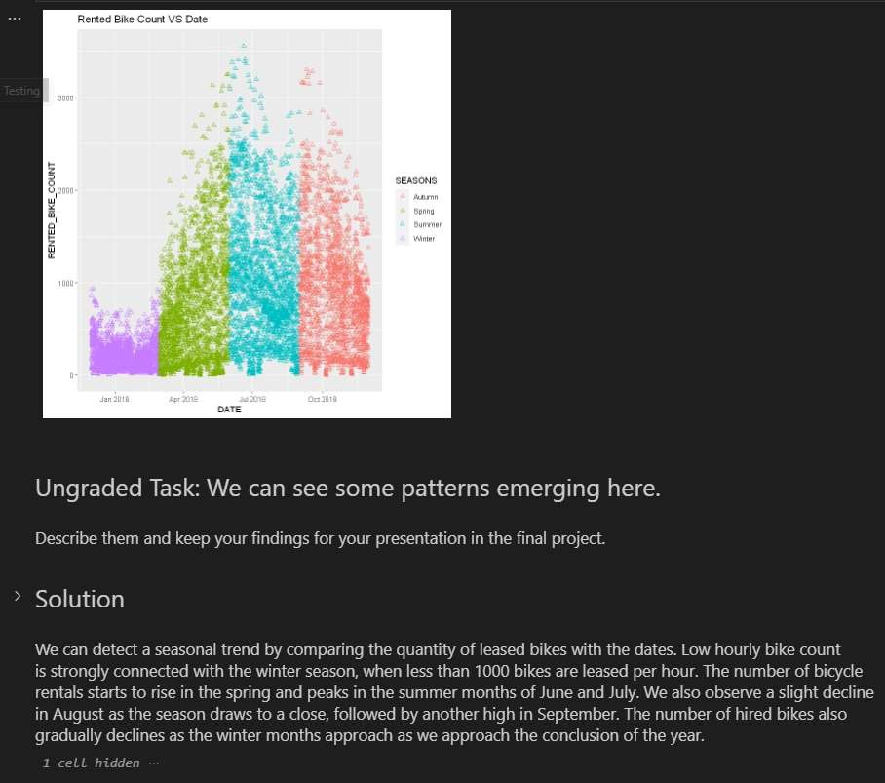
Bike rental vs. Date
We can detect a seasonal trend by comparing the quantity of leased bikes with the dates. Low hourly bike count is strongly connected with the winter season, when less than 1000 bikes are leased per hour. The number of bicycle rentals starts to rise in the spring and peaks in the summer months of June and July. We also observe a slight decline in August as the season draws to a close, followed by another high in September. The number of hired bikes also gradually declines as the winter months approach as we approach the conclusion of the year.

Slide 23
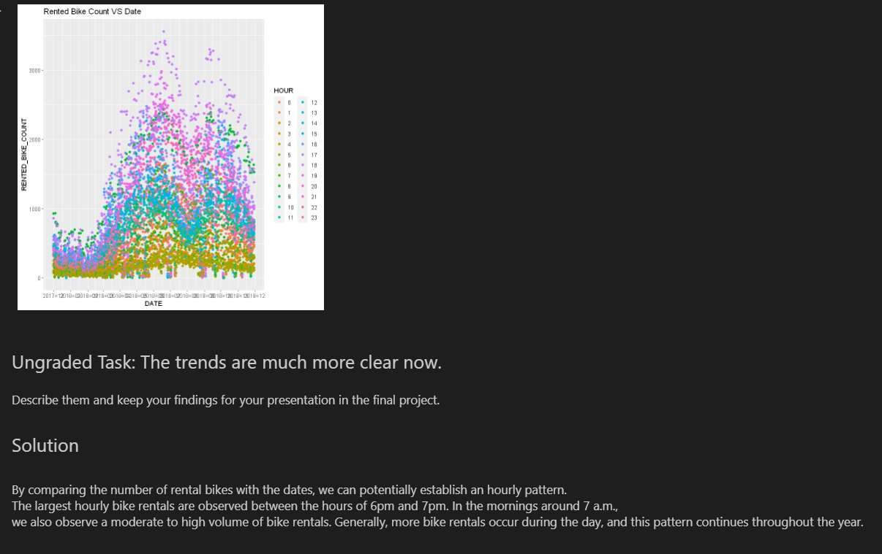
Bike rental vs. Datetime
By comparing the number of rental bikes with the dates, we can potentially establish an hourly pattern. The largest hourly bike rentals are observed between the hours of 6pm and 7pm. In the mornings around 7 a.m., we also observe a moderate to high volume of bike rentals. Generally, more bike rentals occur during the day, and this pattern continues throughout the year.

Slide 24
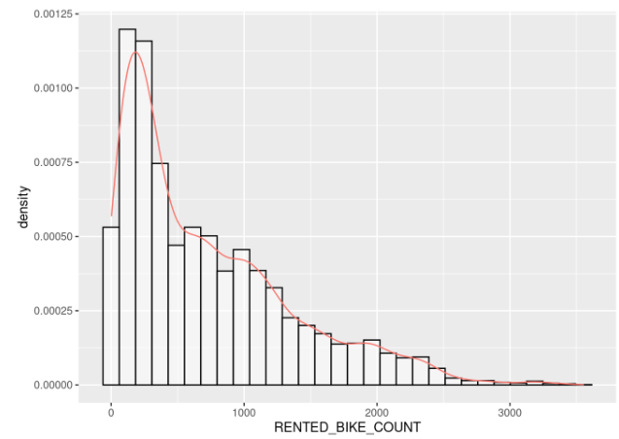
Bike rental histogram
The histogram allows us to see that the distribution of the dataset is skewed to the left. We can also see that the most common count ranges between 0 and 1000 with the mode being 250. This is low as there are 20,000 available bikes, so the leasing could be upgraded.

Slide 25
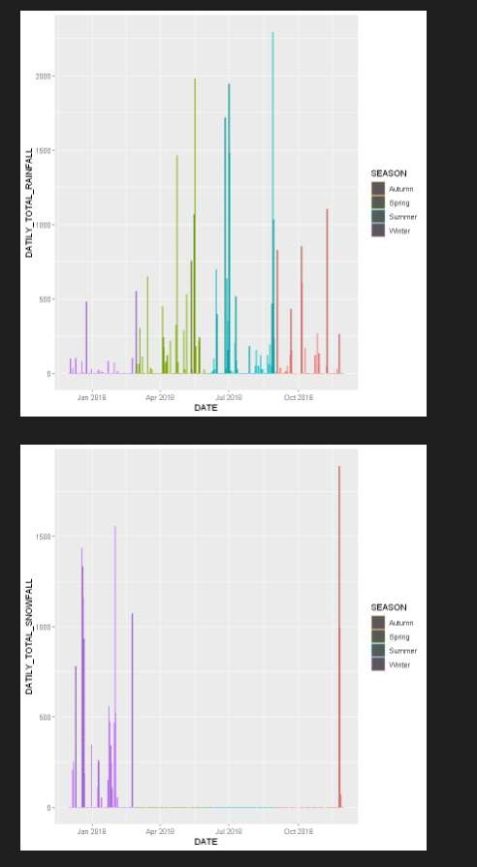
Daily total rainfall and snowfall
This bar chart shows that peak rainfall occurs around September with little or no rainfall during the months of winter like December and January.
This bar chart shows snowfall only occurs during winter between December and January and ends in March.

Slide 26
Predictive analysis

Slide 27
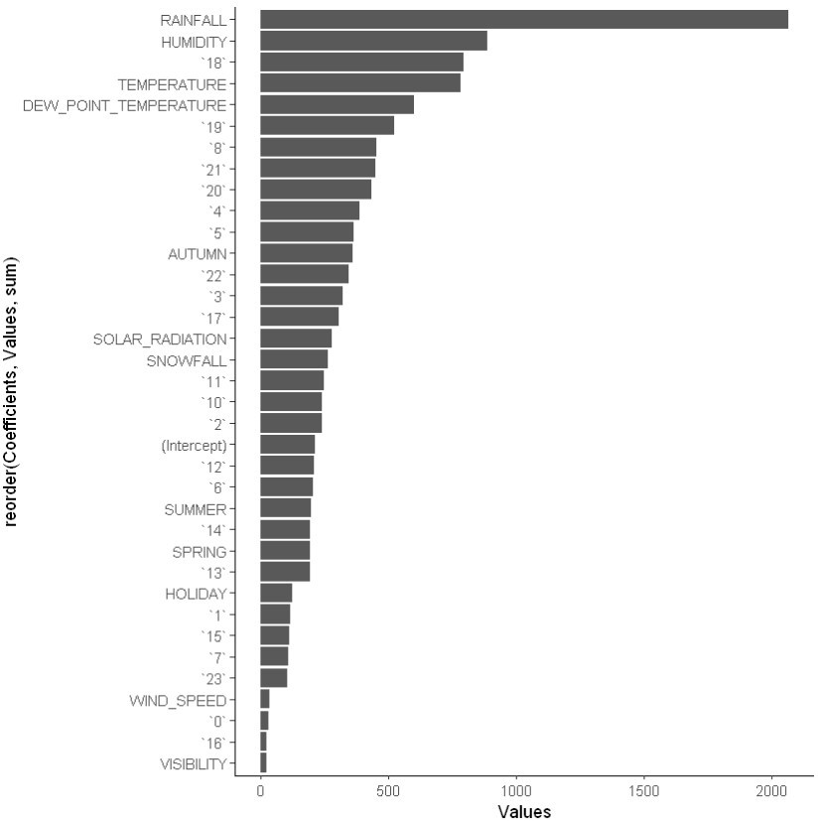
Ranked coefficients
According to the bar chart on the right, the top weather-related variables with the highest coefficients are rainfall, humidity, and temperature. Another significant variable is the hour, which has a large magnitude as well. However, it should be emphasized that many weather-related factors, such as rainfall and temperature, are correlated, so not all weather variables are suitable for predicting bike rentals. Furthermore, rainfall and snowfall are seasonally dependent and hence unsuitable for our model. Finally, because bike rental services are offered all year, the variables 'functional day' and 'holiday' were not included in the final model.

Slide 28
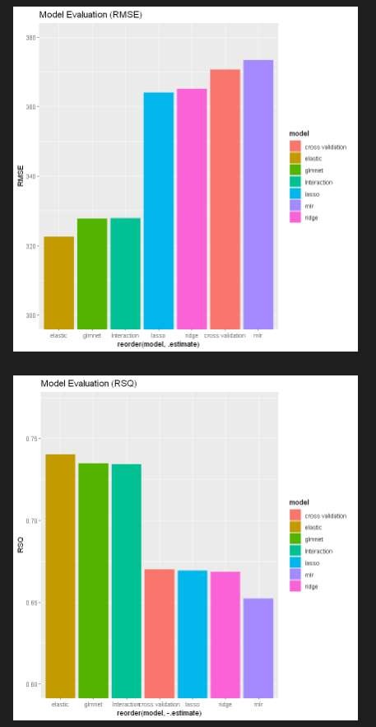
Model evaluation
After taking into account all of the variables, several models were developed using polynomial terms, interaction terms, and regularizations. The Root Mean Squared Error (RMSE) and R Squared (RSQ) metrics were used to assess the performance of each model. The bar charts on the right show the RMSE and RSQ performance of all models.

Slide 29
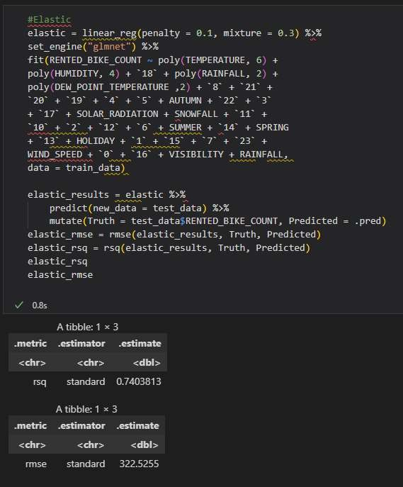
Find the best performing model
By comparing all models, it was deduced that overall, the elastic net regularized model performed best as it has the lowest RMSE (322.5255) and the highest RSQ(0.7403813). Its model formula was:
(RENTED_BIKE_COUNT ~ poly(TEMPERATURE, 6) + poly(HUMIDITY, 4) + `18` + poly(RAINFALL, 2) + poly(DEW_POINT_TEMPERATURE ,2) + `8` + `21` + `20` + `19` + `4` + `5` + AUTUMN + `22` + `3` + `17` + SOLAR_RADIATION + SNOWFALL + `11` + `10` + `2` + `12` + `6` + SUMMER + `14` + SPRING + `13` + HOLIDAY + `1` + `15` + `7` + `23` + WIND_SPEED + `0` + `16` + VISIBILITY + RAINFALL)

Slide 30
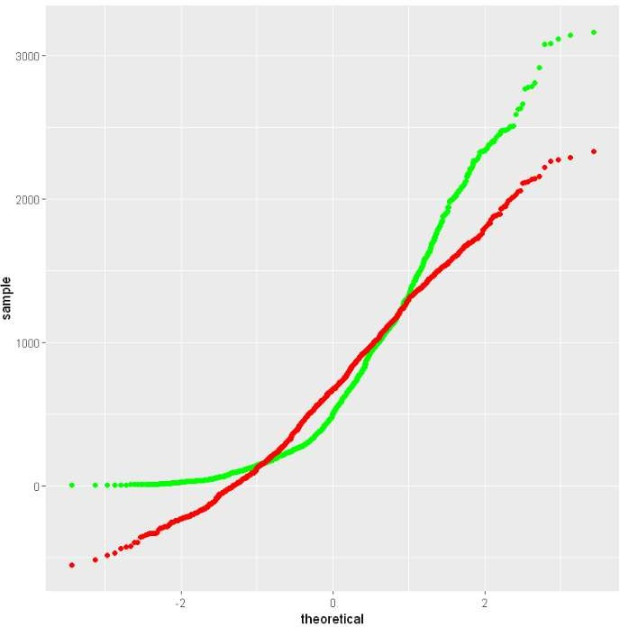
Q-Q plot of the best model
This is the Q-Q plot of the best model’s test results vs the truths

Slide 31
Dashboard

Slide 32
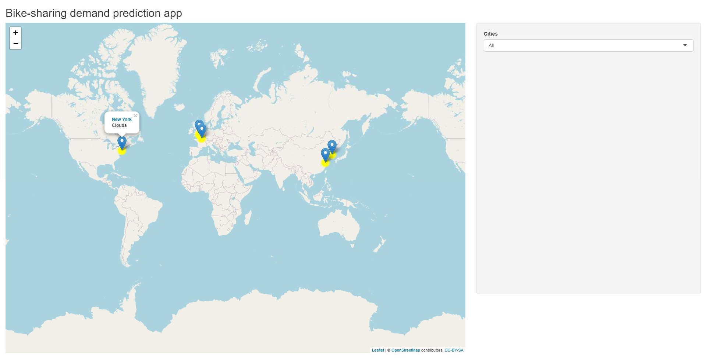
Bike-sharing Demand Dashboard Overview
This screenshot shows cities’ max bike-sharing prediction on a map, and it includes a dropdown list that allows the user to select a specific city.

Slide 33
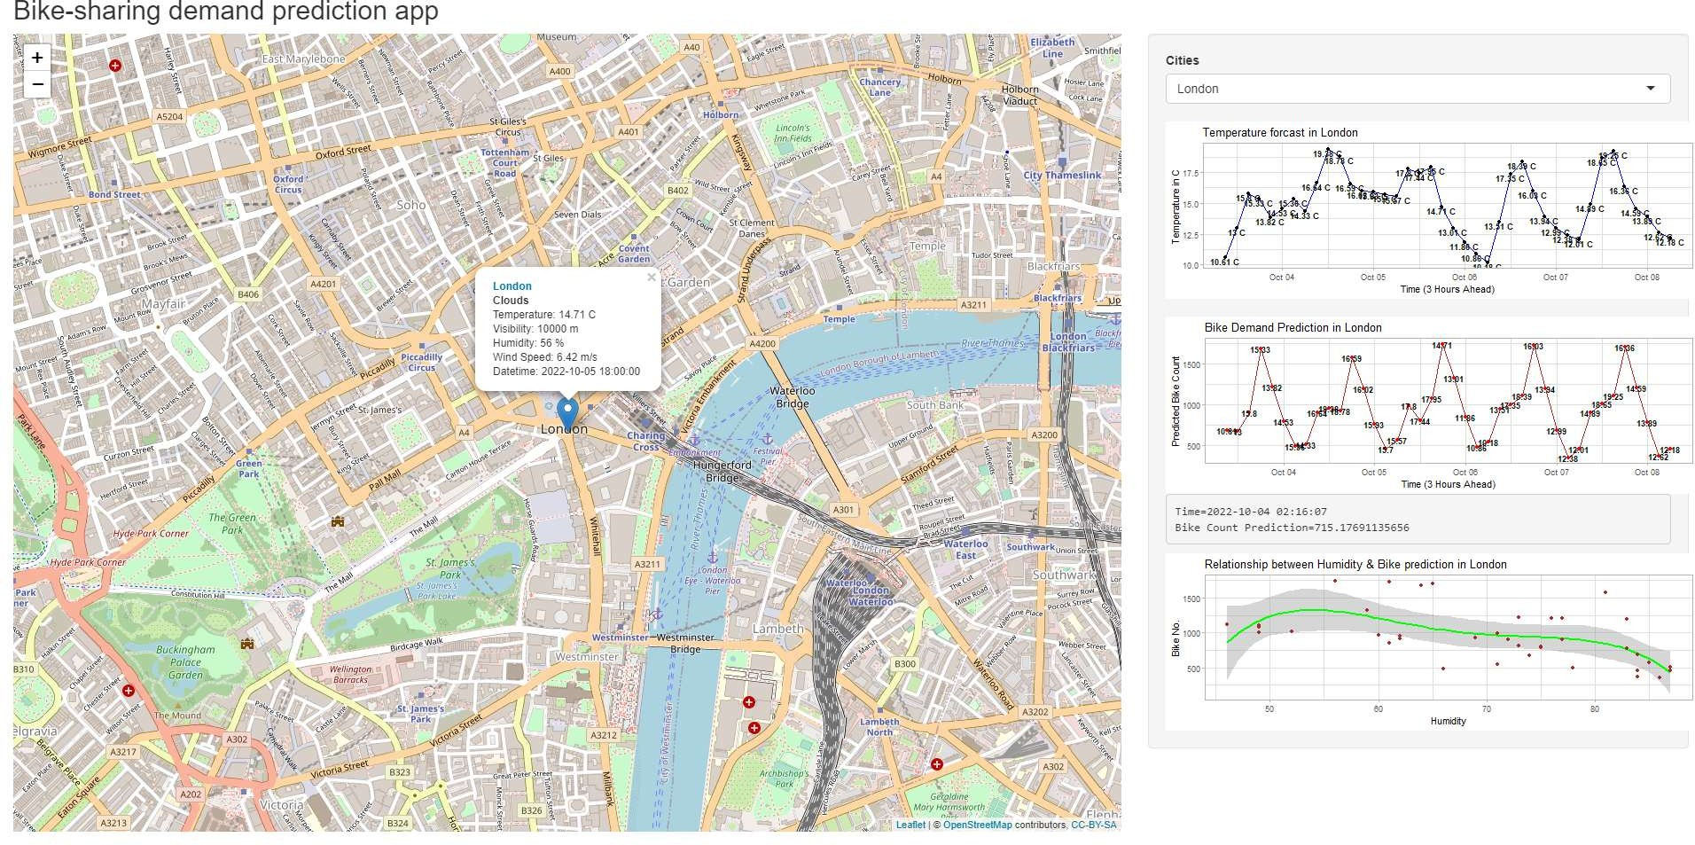
Bike-sharing Demand Overview for London
When a city is selected, such as London, the dashboard also displays temperature forecast and the relationship between humidity and bike prediction, all for the selected city.

Slide 34
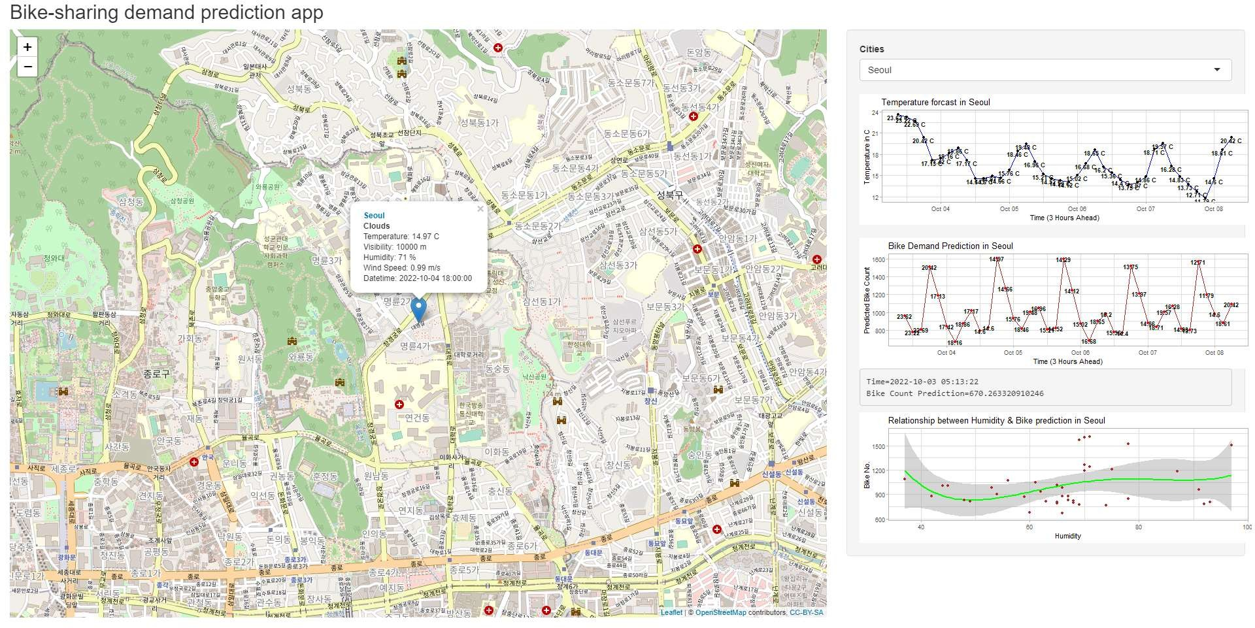
Bike-sharing Demand Overview for Seoul
As with London, selecting Seoul changes the dashboard to now show a map of that city as well as the other plots previously mentioned.

Slide 35

CONCLUSION
The highest demand for bike sharing services is in the summer months.
On a day-to-day basis, the highest demand is located between 6 and 7 P.M.
Unlike summer, winter months have the lower demand for bike sharing.
Humidity and temperature have a lot of influence on the quantity of bikes leased, at any given hour.

Slide 36

APPENDIX
Include any relevant assets like R code snippets, SQL queries, charts, Notebook outputs, or data sets that you may have created during this project

Slide 37
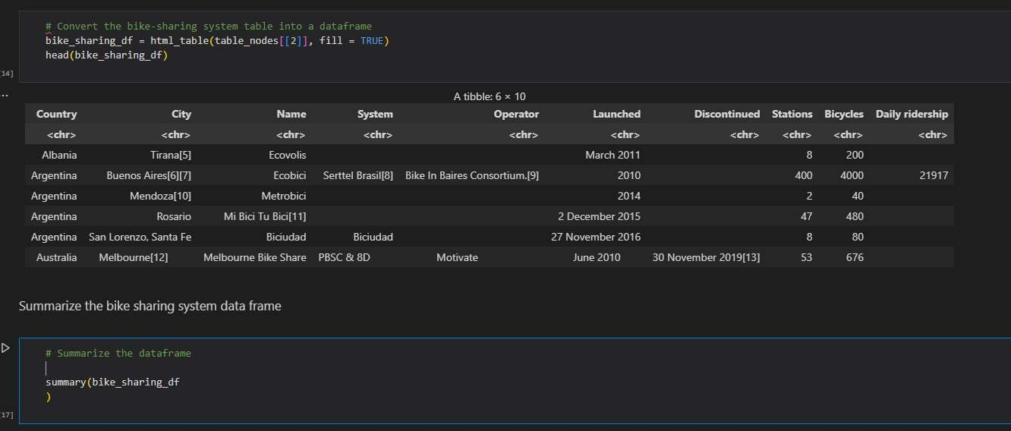

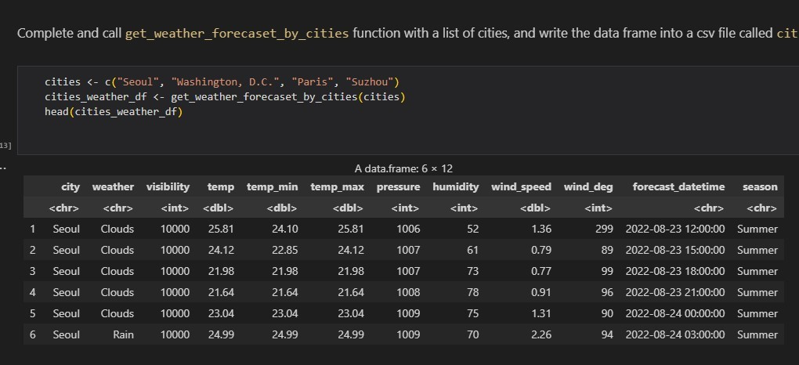
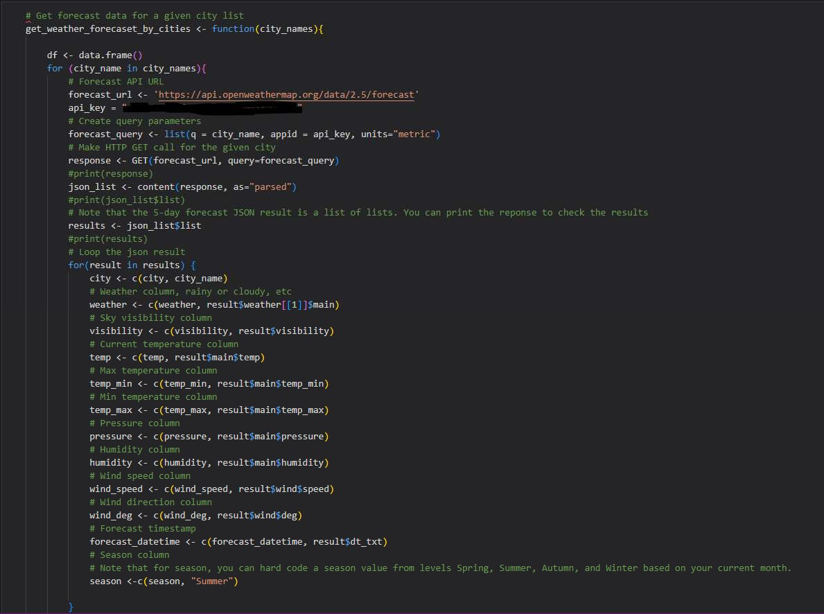
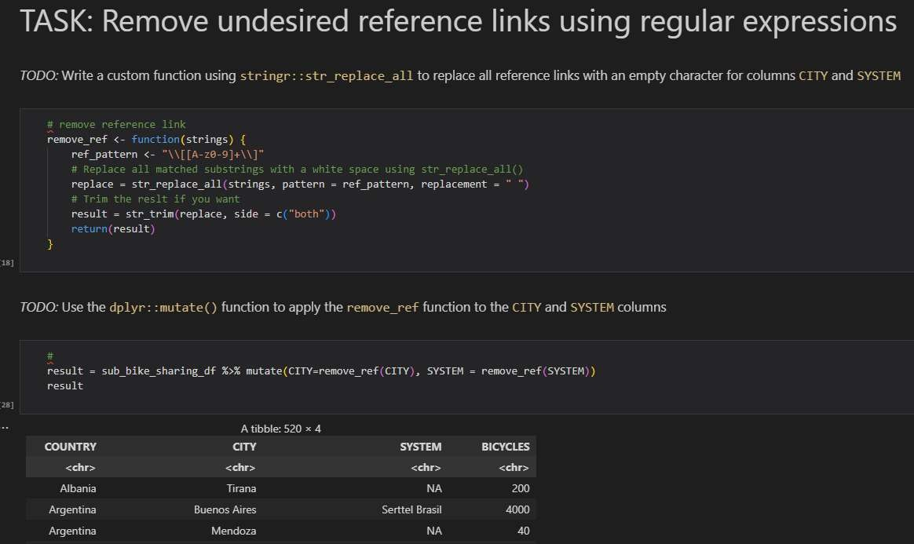
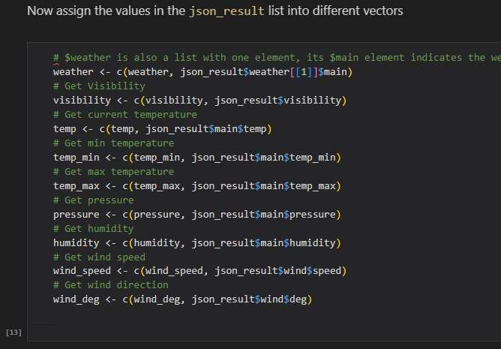
APPENDIX

Slide 38
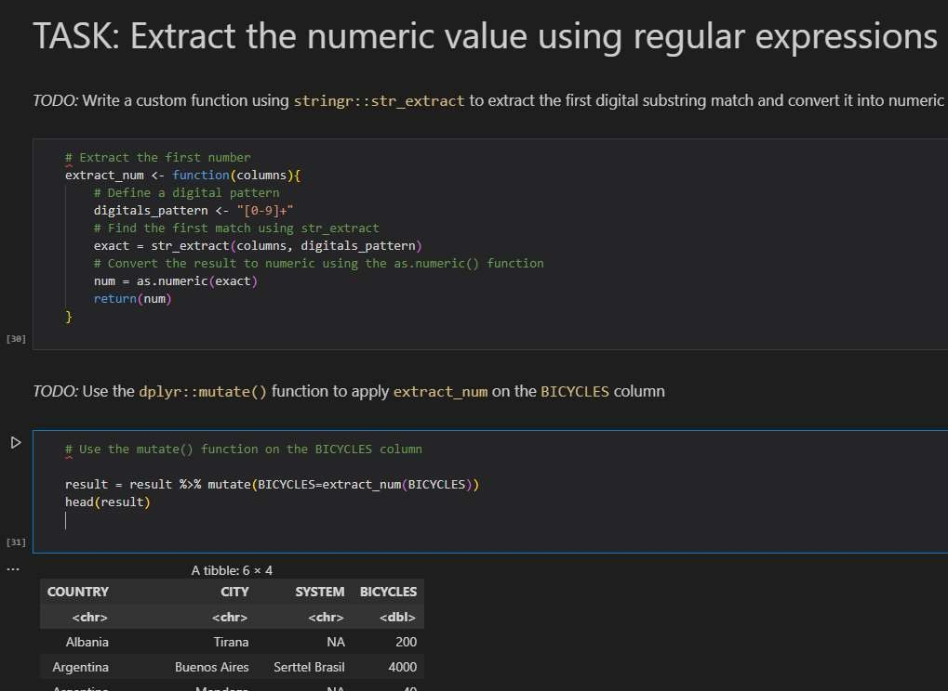
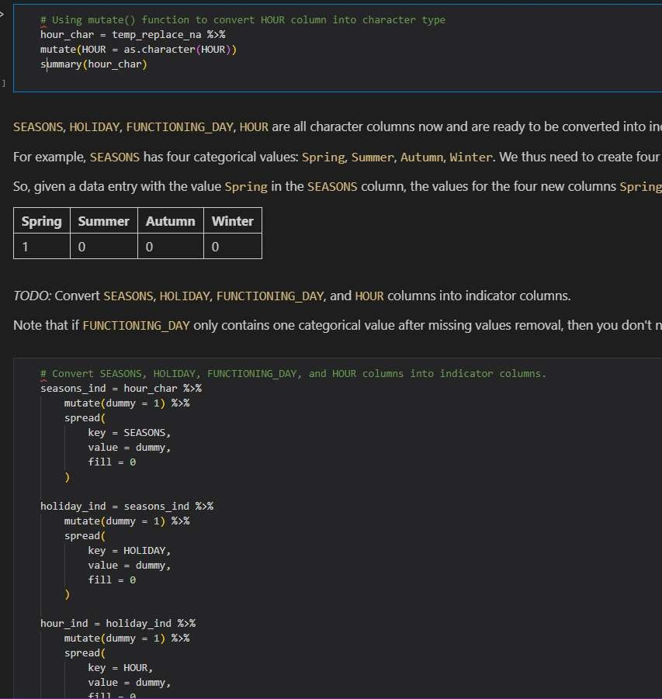
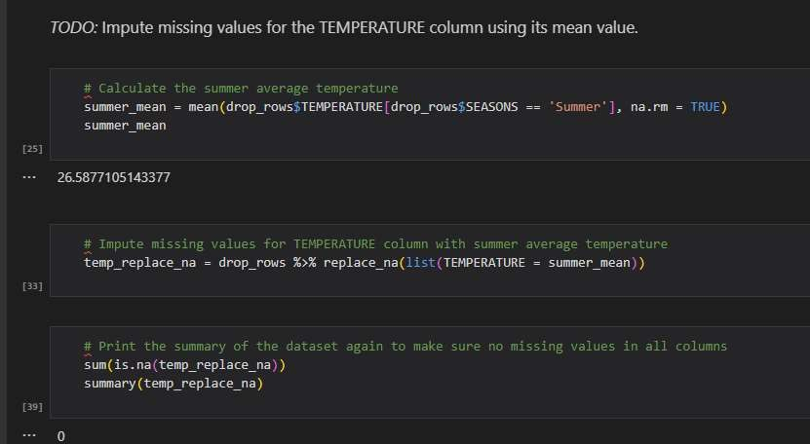
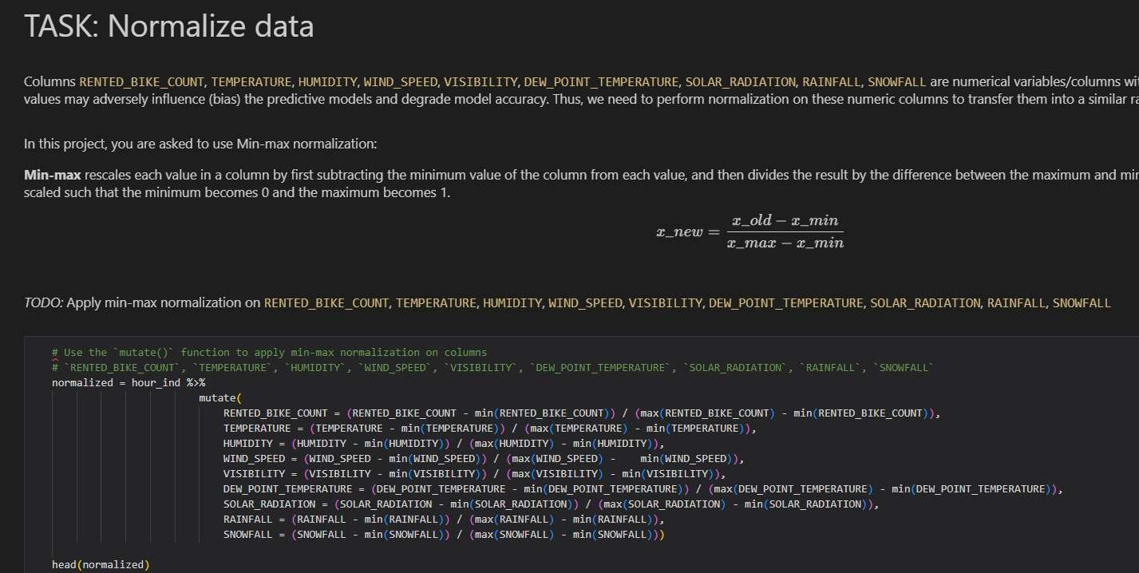
APPENDIX

Slide 39

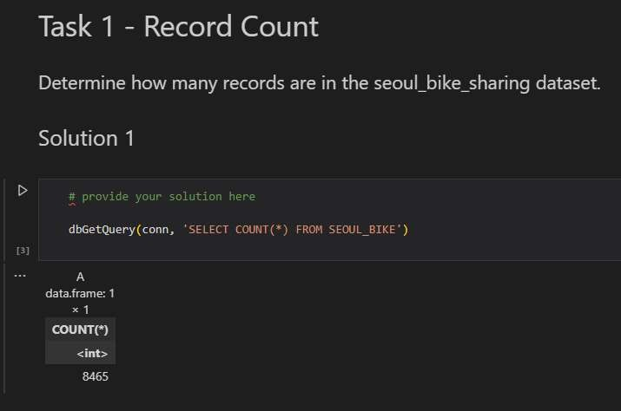
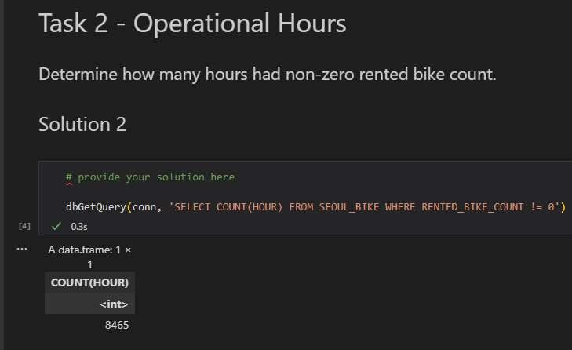
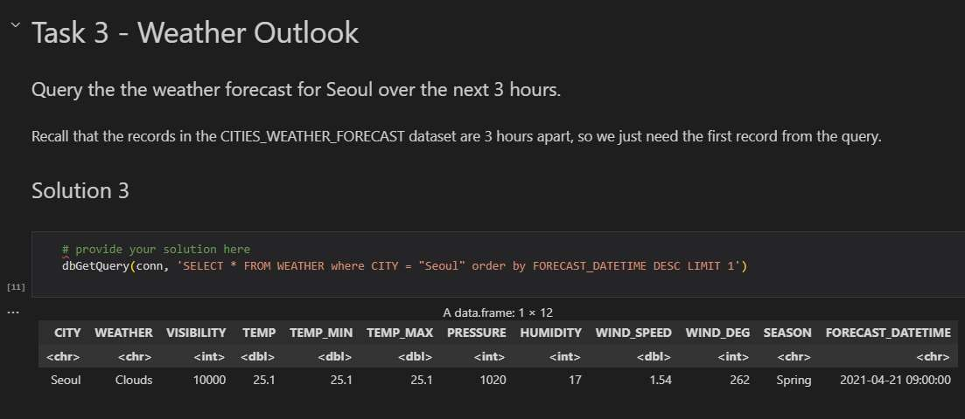
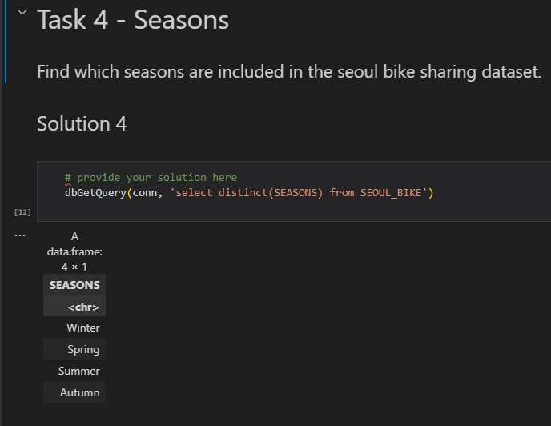
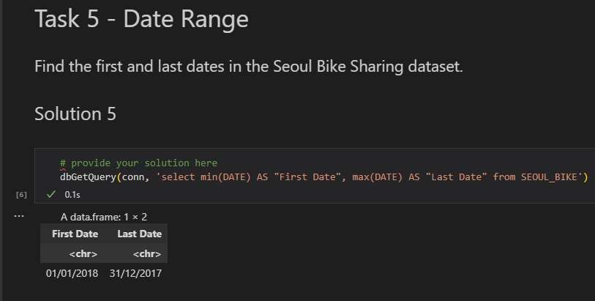
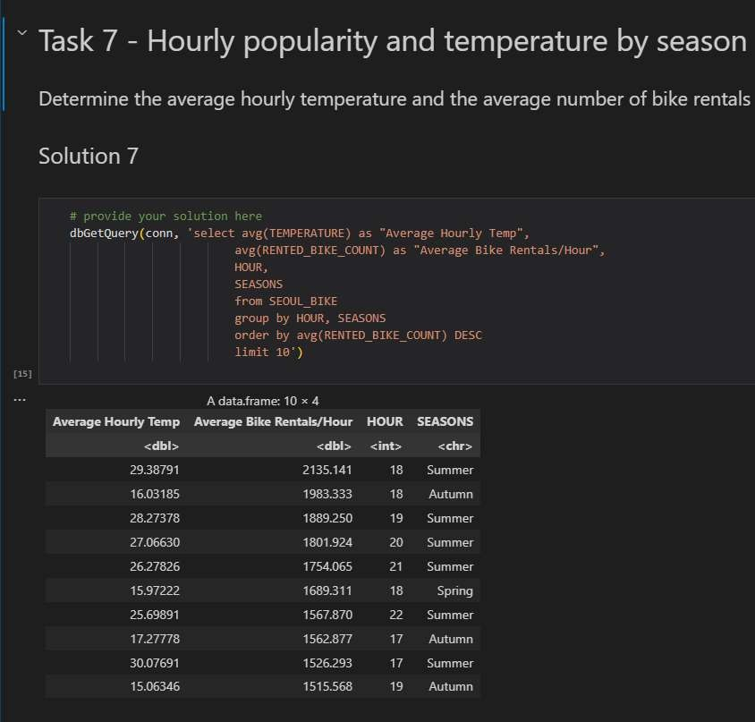
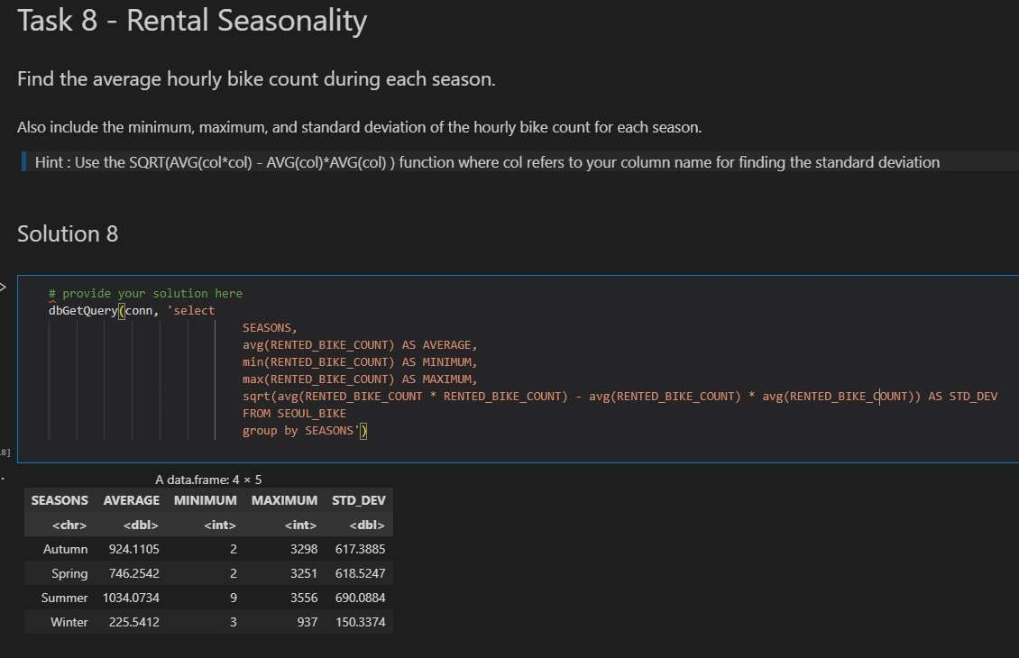
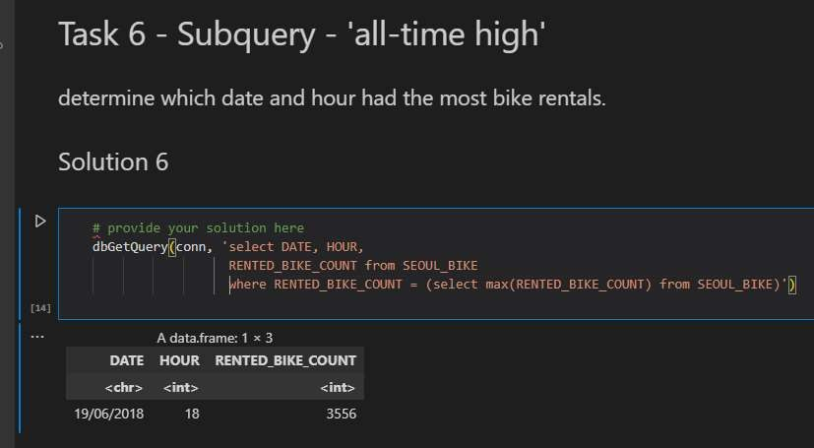
APPENDIX

Slide 40
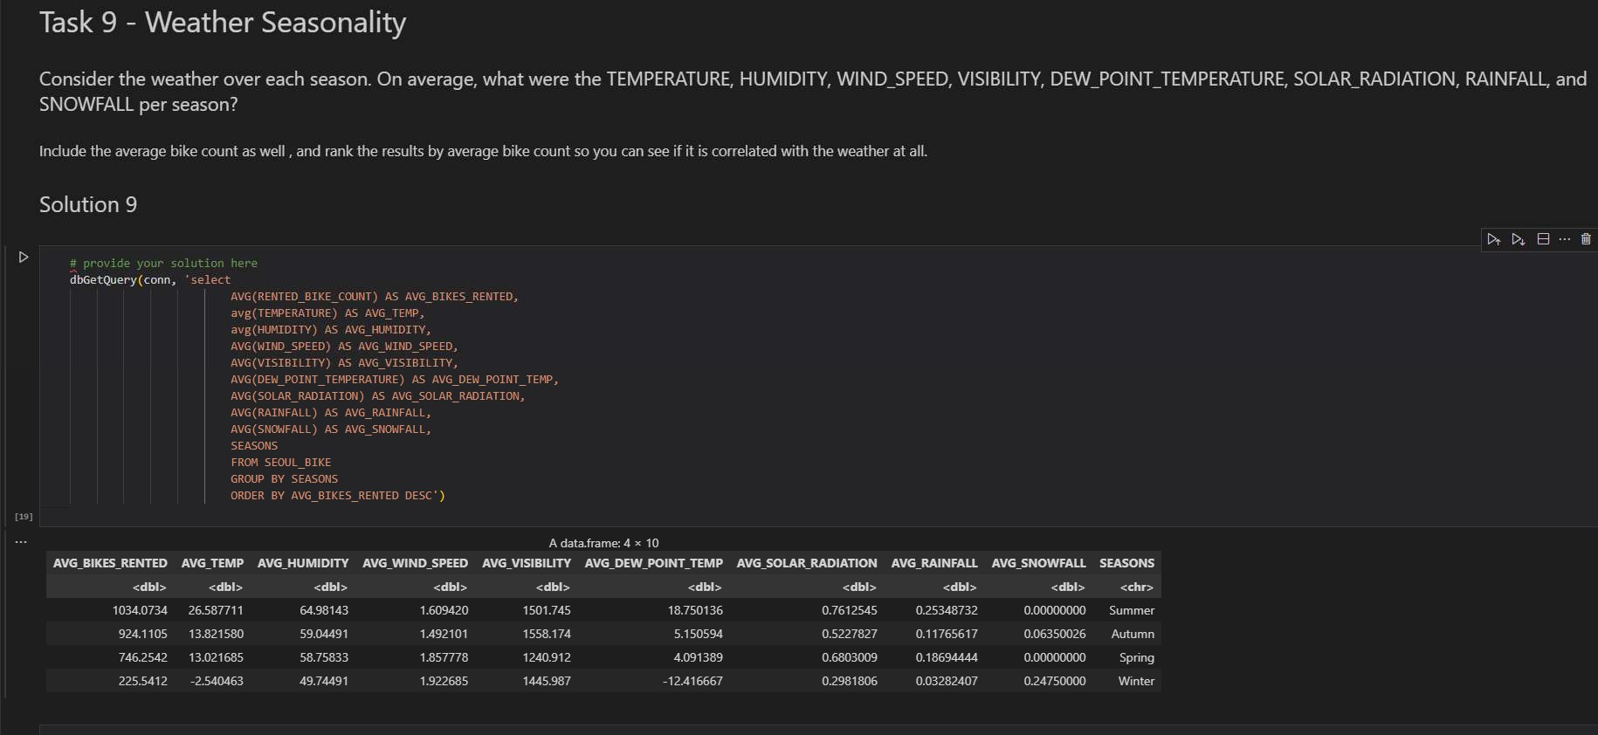
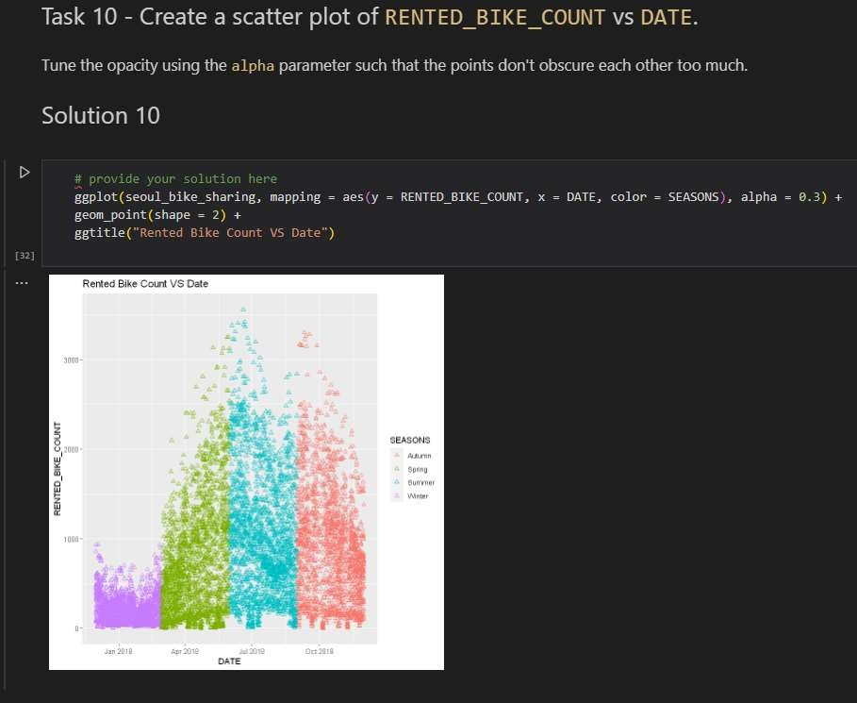
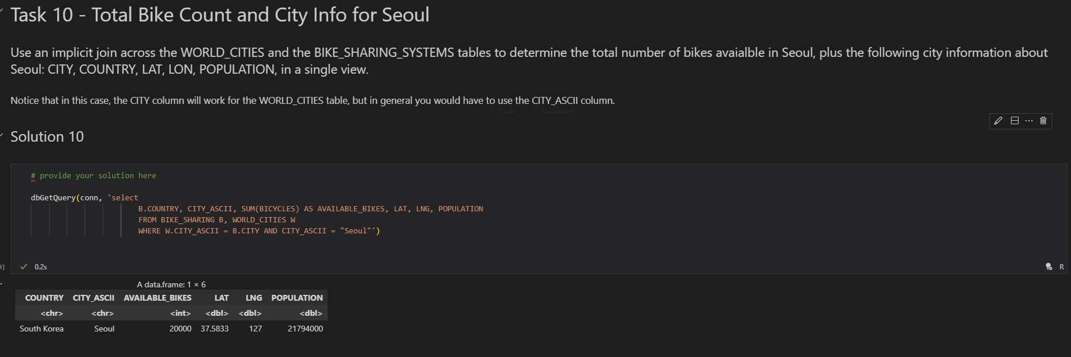
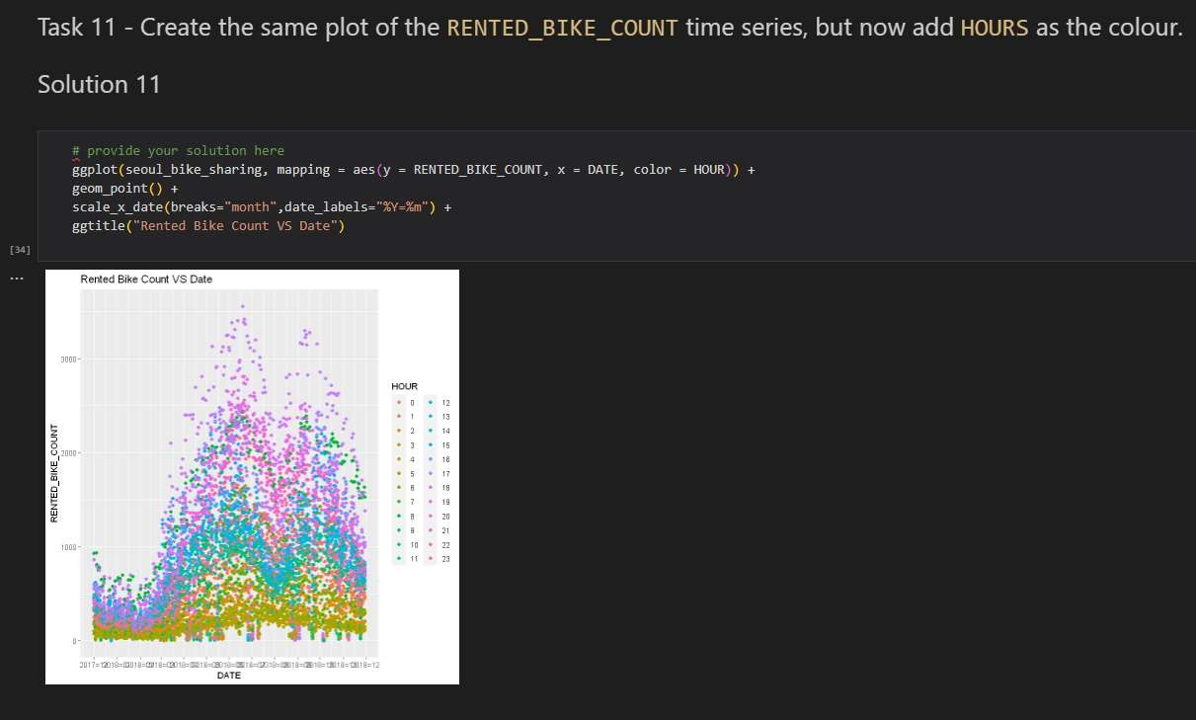
APPENDIX

Slide 41
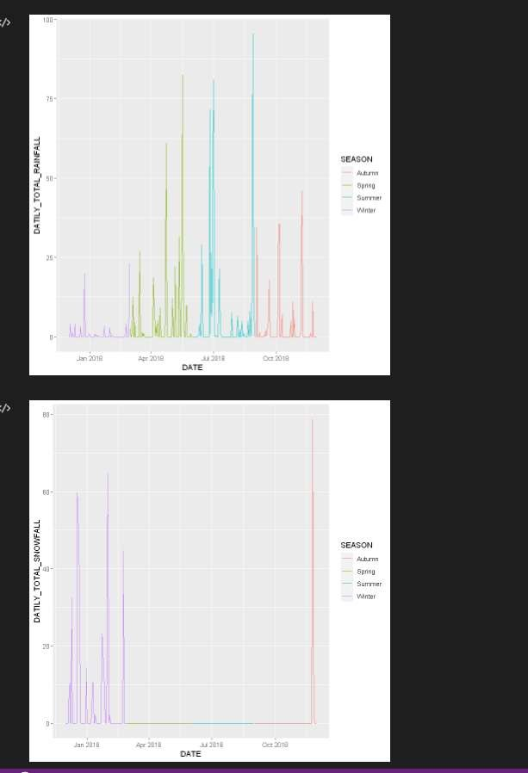
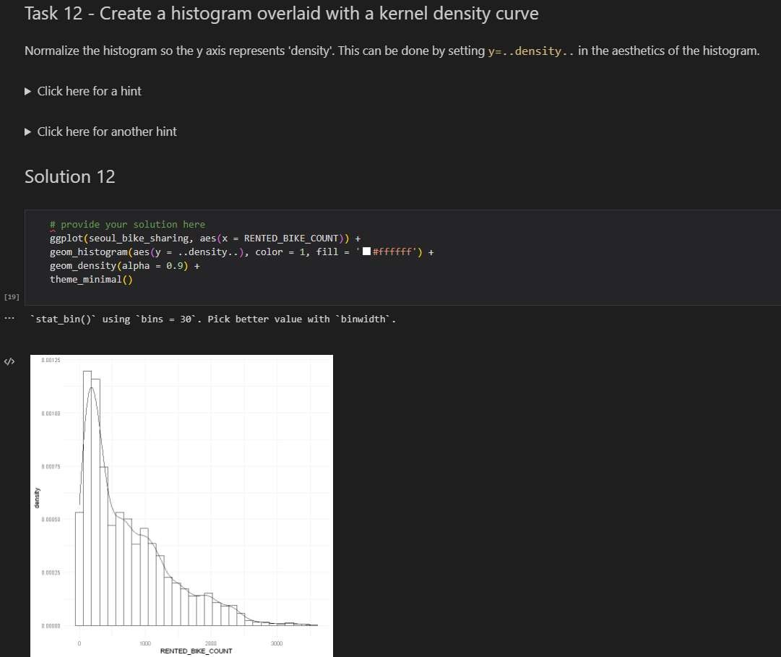
APPENDIX

